Slide 1


Cardiovascular Disease Prediction
SIC – AI701
Notes:
Note:
1

Slide 2
Agenda
Team Members
Motivation
Dataset Description
Data Cleaning & Pre-processing
Exploratory Data Analysis (EDA)
Feature Selection
Pipeline & Model Selection
Best Models & Final Results
Deployment
Future Enhancements
Samsung Innovation Campus

Slide 3
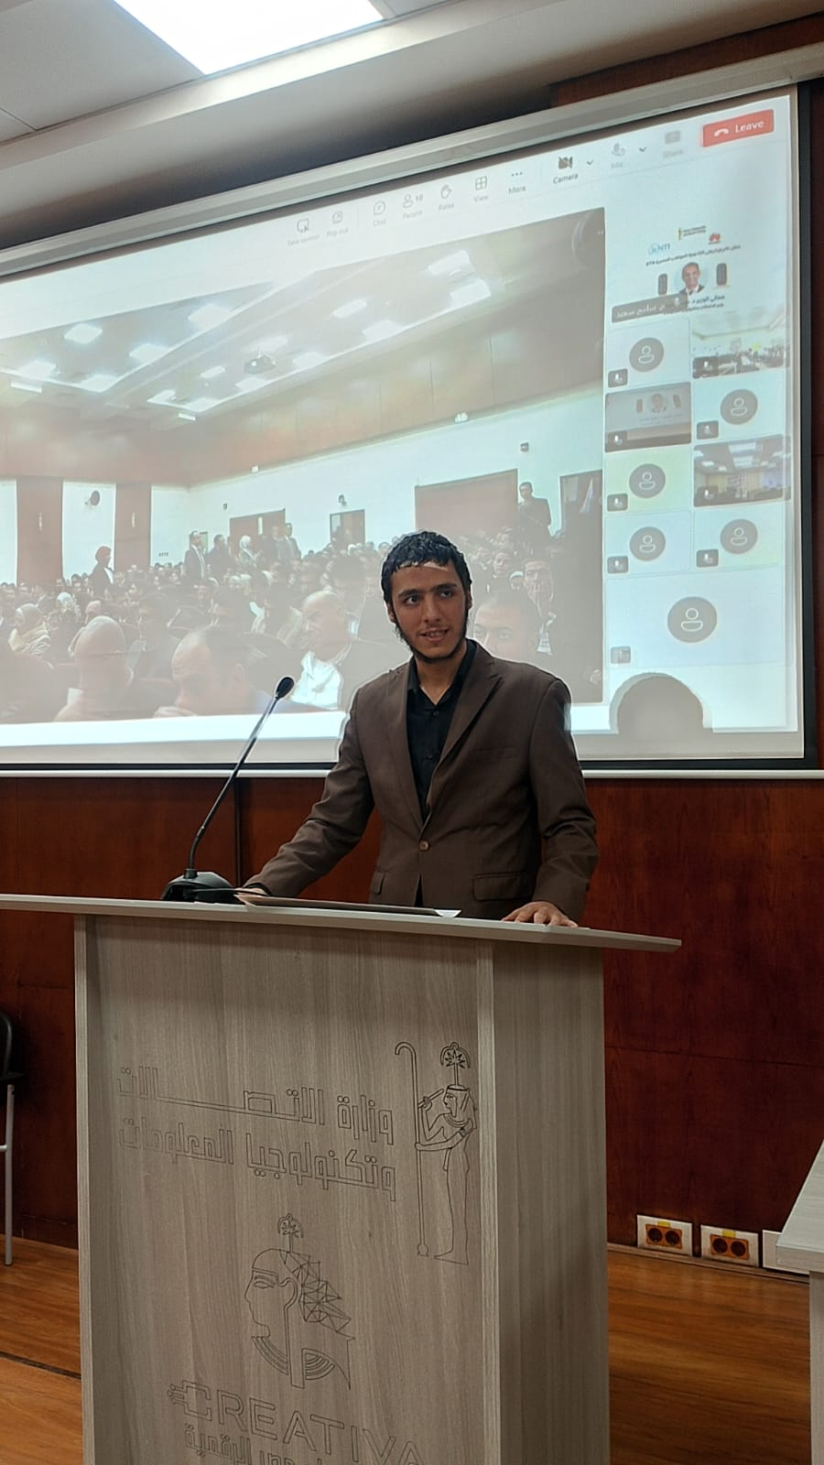

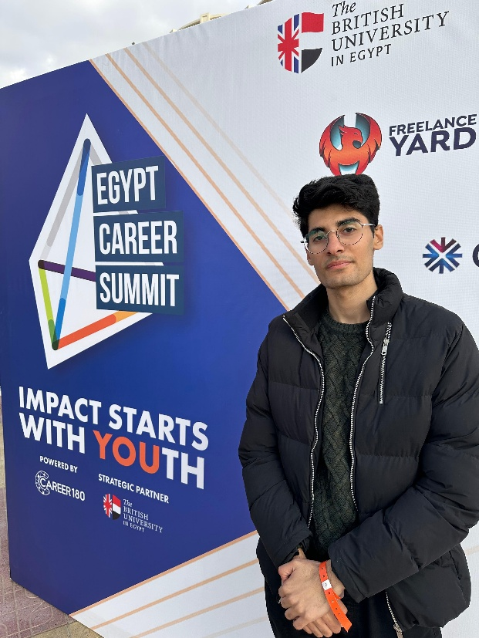

Team Members
Ahmed Hany
Abdelrahman Mohamed
Ahmed Tamer
Samsung Innovation Campus

Slide 4
Motivation
Samsung Innovation Campus
Notes:
Note:
2

Slide 5
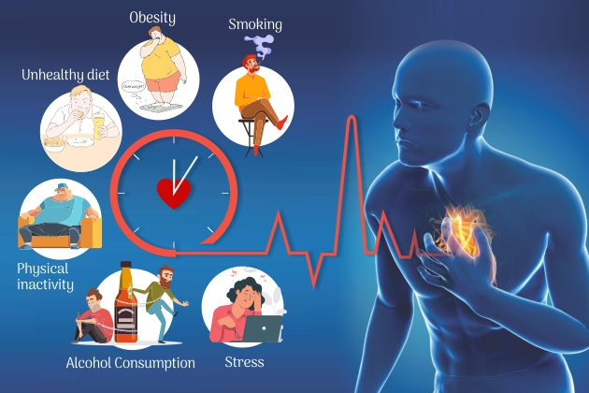
Motivation
Cardiovascular disease (CVD) is the leading cause of death worldwide (e.g., 17.9 million deaths annually)
Early prediction using ML can identify at-risk patients based on factors like age, blood pressure, cholesterol, smoking, etc.
Challenges: Traditional diagnosis is invasive/expensive; ML can make it faster and more objective.
Samsung Innovation Campus

Slide 6
Dataset Description
Samsung Innovation Campus
Notes:
Note:
2

Slide 7
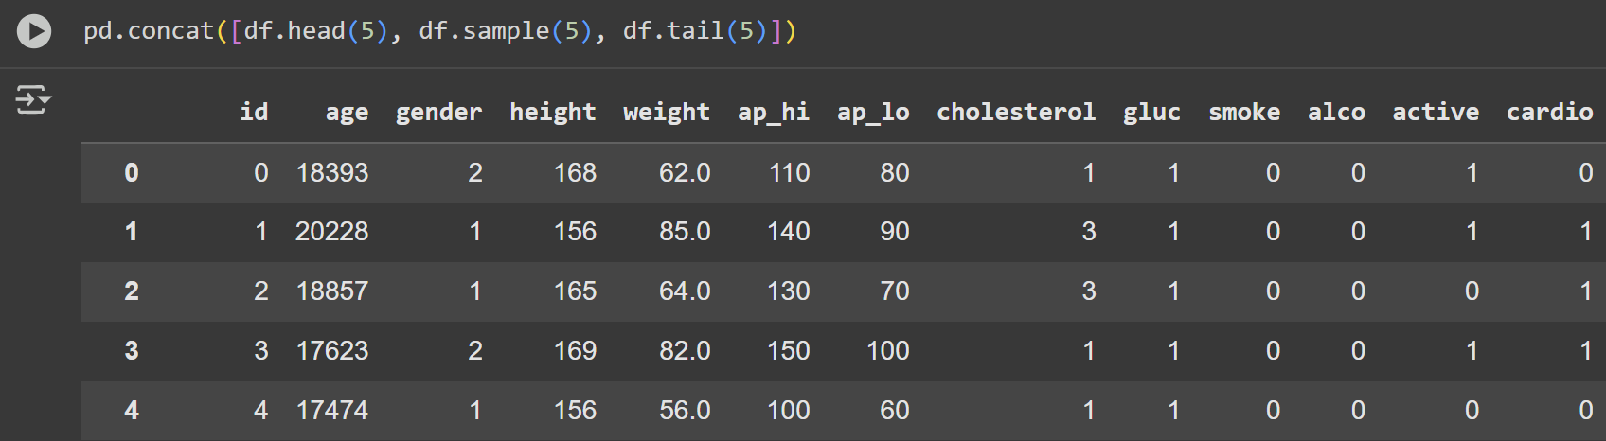
Dataset Description
Source: Kaggle Cardiovascular Disease Dataset
Size: 70,000 patient records, 12 features
Feature Categories (collected during medical examinations):
Objective (Factual Information): Age (in days), Height (cm), Weight (kg), Gender (categorical code: 1 for women, 2 for men)
Examination (Medical Results): Systolic blood pressure, Diastolic blood pressure, Cholesterol (1: normal, 2: above normal, 3: well above normal), Glucose (1: normal, 2: above normal, 3: well above normal)
Subjective (Patient-Reported): Smoking (binary: 0/1), Alcohol intake (binary: 0/1), Physical activity (binary: 0/1)
Target Variable: 'cardio' (binary: 1 for CVD present, 0 for absent)

Slide 8
Data Preprocessing
Samsung Innovation Campus
Notes:
Note:
2

Slide 9
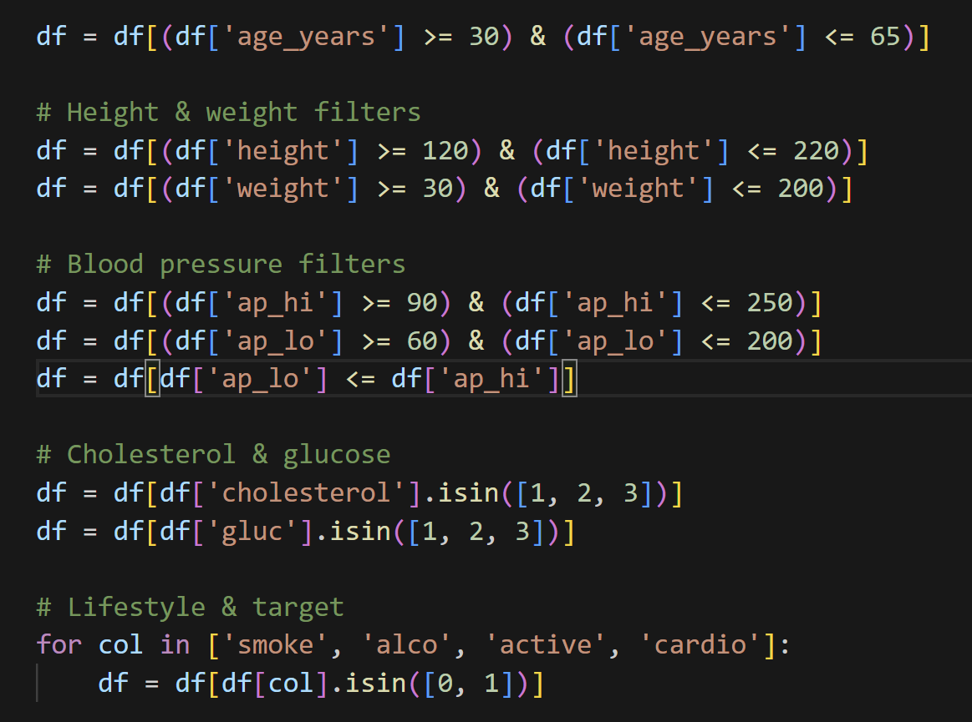
Data Cleaning & Pre-processing
Data Cleaning:
1-Removed unrealistic readings. 2-No missing values were found. 3-No duplicate records were present. 4-Converted age from days to years.
Feature Engineering: Created a new 'BMI' (Body Mass Index) feature using weight and height. This helps assess obesity, a key factor in heart disease risk, by combining two raw measurements into one useful indicator.
Data Transformation: Adjusted all numerical values (like age, height, weight, and blood pressure) to a common scale using a normalization technique. Categorical values (e.g., cholesterol levels) were kept as ordinal (1-3 scale) because they represent ordered categories. Binary features (e.g., smoking) remained unchanged as they are already in a suitable format.

Slide 10
EDA
Samsung Innovation Campus
Notes:
Note:
2

Slide 11
EDA
Key Insights from Descriptive Statistics
The dataset includes 70,000 records with a nearly balanced distribution of CVD cases (~50% with CVD, ~50% without). Age, converted to years, ranges from 30 to 65, with older individuals showing a higher prevalence of CVD. Blood pressure and cholesterol levels exhibit greater variability among those with CVD.
Samsung Innovation Campus
Notes:
Note:
4

Slide 12
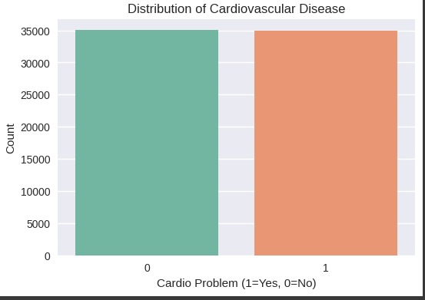
Class Distribution
Bar chart shows a balanced ~50/50 split (35,000 each for 0 and 1), ensuring fair model training without imbalance issues.
Samsung Innovation Campus
Notes:
Note:
4

Slide 13
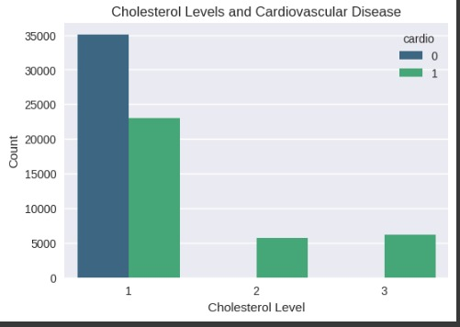
Cholesterol Levels
This bar chart illustrates the relationship between cholesterol levels (1=normal, 2=above normal, 3=well above normal) and CVD presence.
Higher cholesterol levels (2 and 3) show an increased count of CVD cases, suggesting a positive correlation that could be a key predictor in the analysis.
Samsung Innovation Campus

Slide 14
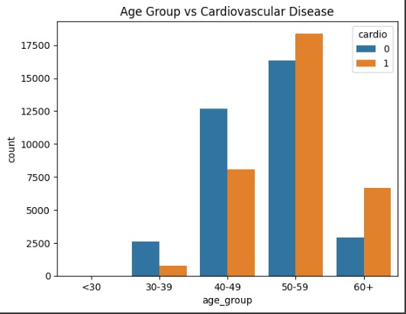
Age Group Impact
Bar chart highlights rising CVD prevalence after age 50, marking age as a critical predictor.
Samsung Innovation Campus

Slide 15
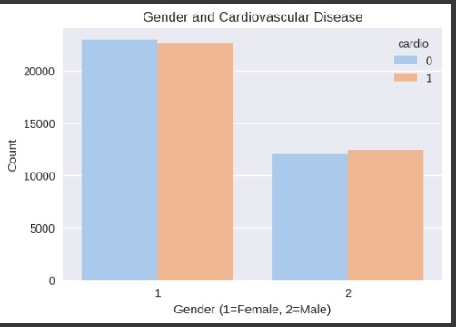
Gender Effect
Bar chart shows similar CVD counts for both genders, indicating minimal gender impact.
Samsung Innovation Campus

Slide 16
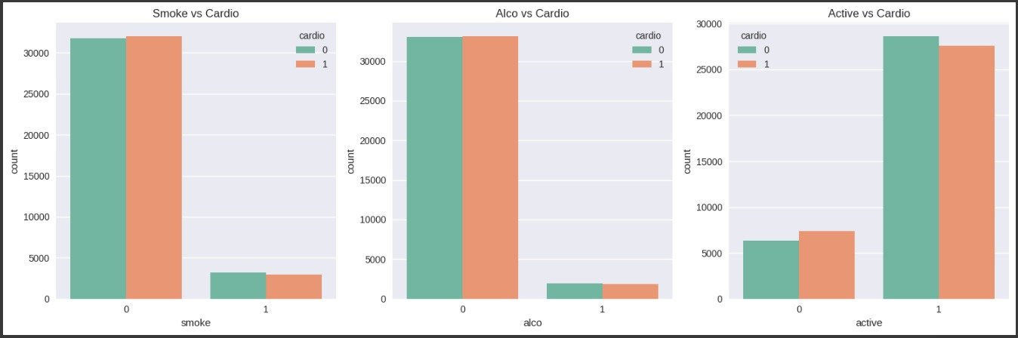
Lifestyle Factors
Triple bar chart suggests slight CVD increases with smoking/alcohol, and a protective effect with activity.
Samsung Innovation Campus

Slide 17
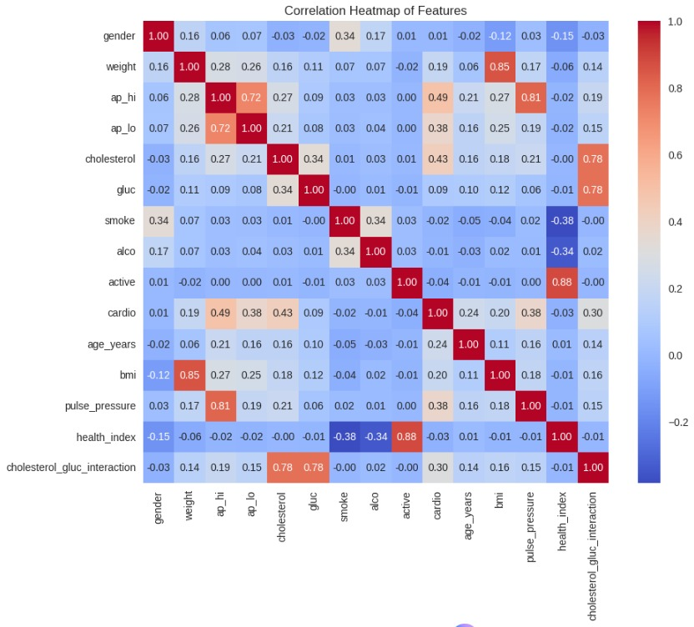
Correlations
This heatmap reveals correlations among features, with strong positive links between age, blood pressure, and CVD. Moderate correlations with BMI and cholesterol highlight these as important predictors; while smoking and alcohol show weaker ties, informing feature selection.
Samsung Innovation Campus

Slide 18
Pipeline & Model Selection
Samsung Innovation Campus
Notes:
Note:
2

Slide 19
Pipeline & Model Selection
Decision Tree with max depth = 10 performed best.
Focused on balancing accuracy and generalization.
Tried multiple ML models for classification (Logistic Regression, Random Forest, etc.)
Samsung Innovation Campus
Notes:
Note:
9

Slide 20
Best Model & Final Results
Samsung Innovation Campus
Notes:
Note:
2

Slide 21
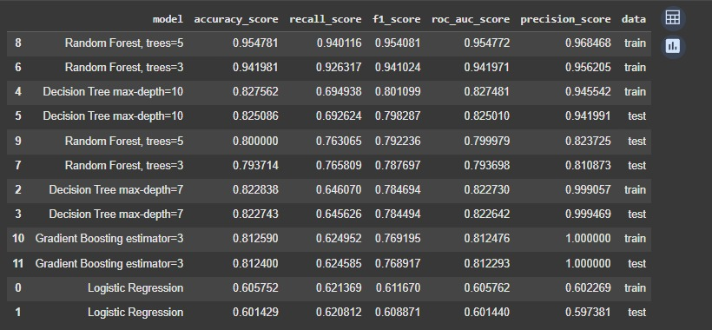
Final Results
Achieved 83% accuracy (dataset average 70–75%).
Overfitting check: training vs. testing accuracy similar → model generalizes well.
F1 Score = 80% → chosen as main metric because medical predictions need high precision & recall.

Slide 22
Deployment
Samsung Innovation Campus
Notes:
Note:
2

Slide 23
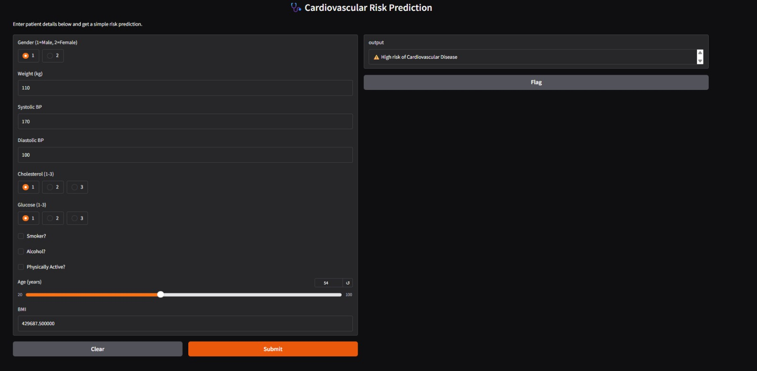
Deployment – Test Case 1
New patient medical record (age, blood pressure, cholesterol, lifestyle factors).
Model Prediction: High risk of cardiovascular disease (CVD).
Interpretation: The system correctly flagged the patient as at-risk, showing that the model can be useful in early detection.

Slide 24
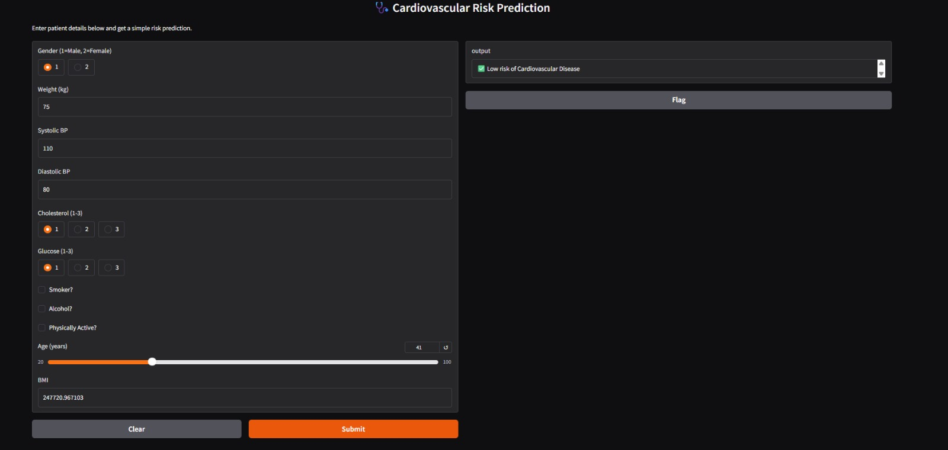
Deployment – Test Case 2
Another unseen patient medical record.
Model Prediction: Low risk of cardiovascular disease (CVD).
Interpretation: The system identified this patient as not at risk, confirming its ability to differentiate between healthy and at-risk individuals

Slide 25
Future Enhancements
Samsung Innovation Campus
Notes:
Note:
2

Slide 26
Future Enhancements
Add more features (family history, diet, lifestyle).
Try ensemble models (Random Forest, Gradient Boosting) for higher robustness.
Validate results with medical professionals.
Samsung Innovation Campus
Notes:
Note:
9

Slide 27

ⓒ2020 SAMSUNG. All rights reserved.
Samsung Electronics Corporate Citizenship Office holds the copyright of book.
This book is a literary property protected by copyright law so reprint and reproduction without permission are prohibited.
To use this book other than the curriculum of Samsung innovation Campus or to use the entire or part of this book, you must receive written consent from copyright holder.
Notes:
14

